Slide 1
Mercenaries and Disaster Capitalism in the Congo Crisis
By Thor Leo Whitaker

Slide 2

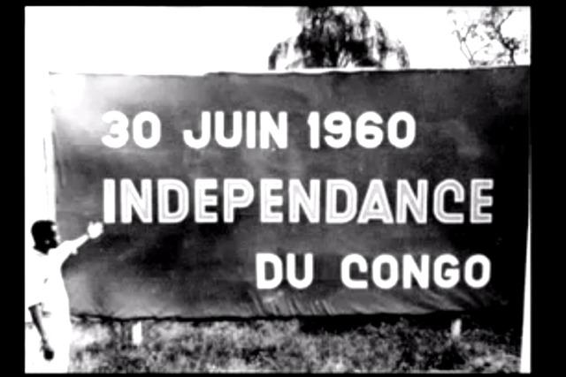
Introduction
My Thesis.
Why it matters?
Why I’m interested?

Slide 3
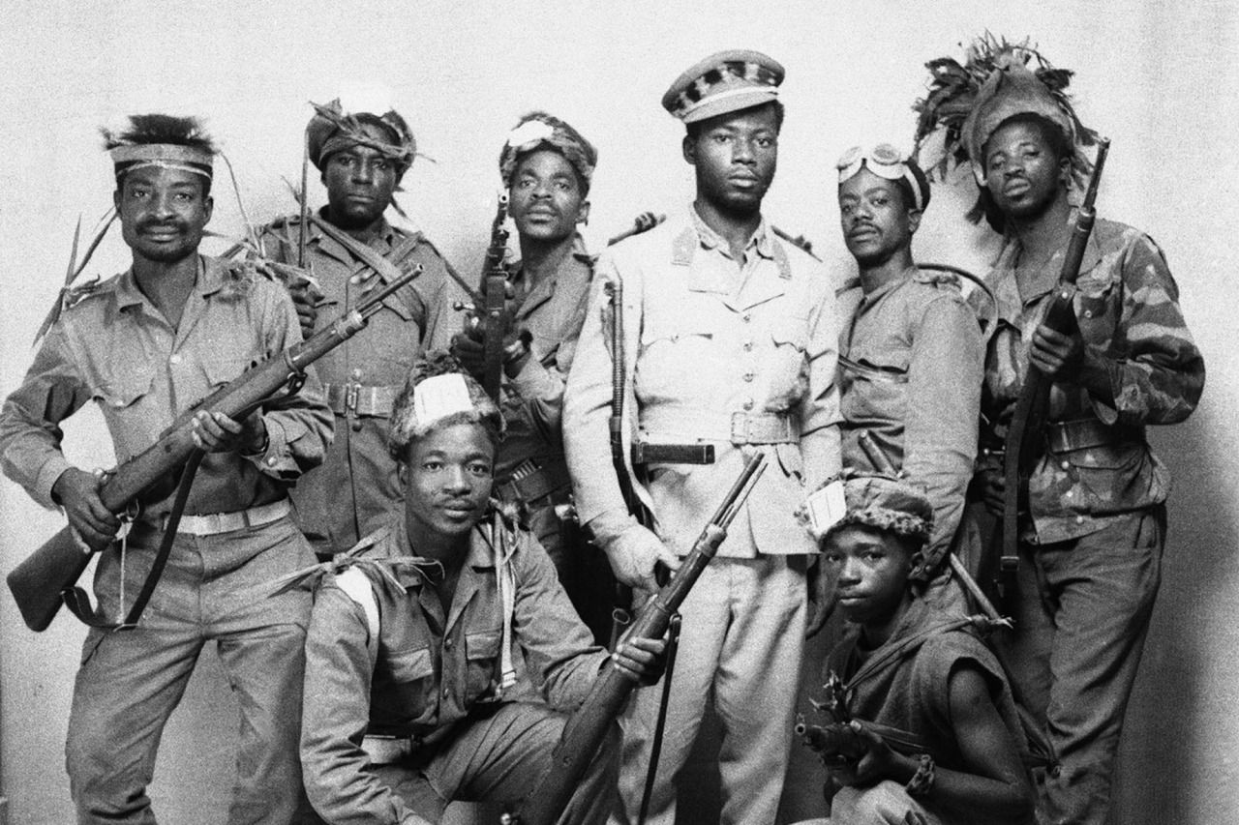
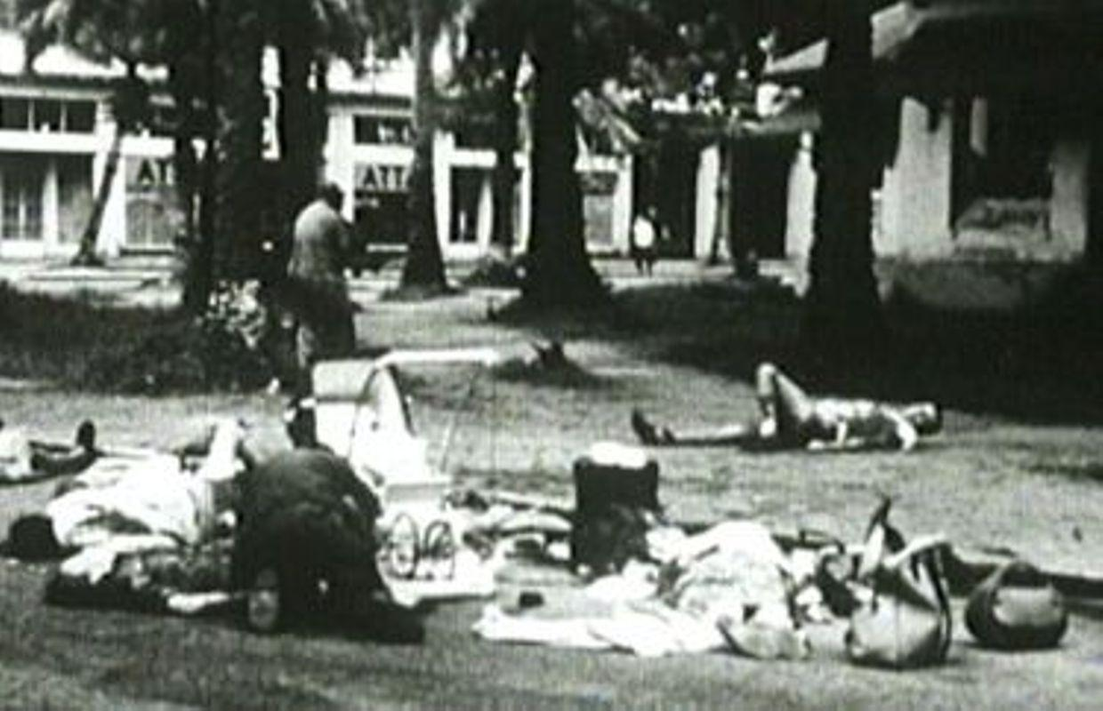
Organization
Background Info.
Katanga and UMHK.
Moïse Tshombe.
Mercenaries themselves.
Conclusion.

Slide 4
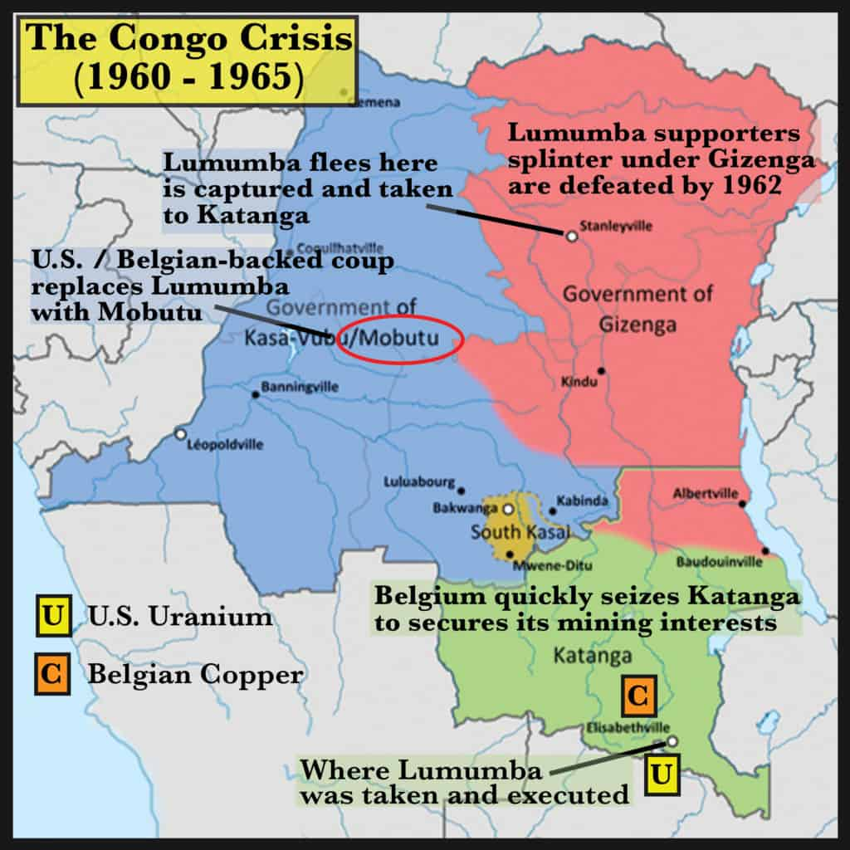
Background Info
Congo Crisis.
Disaster Capitalism.
Mercenaries.

Slide 5

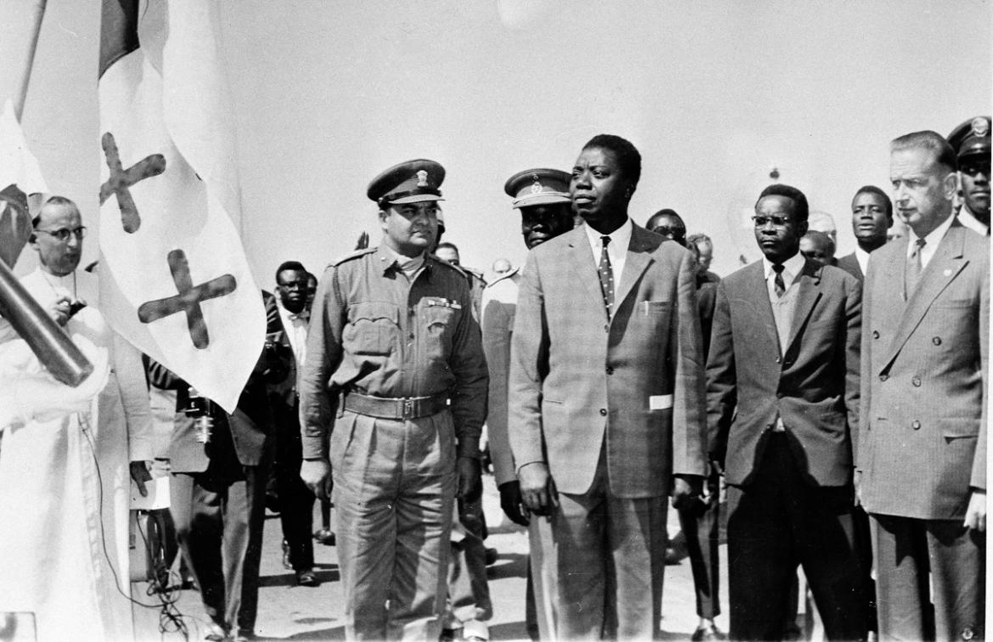
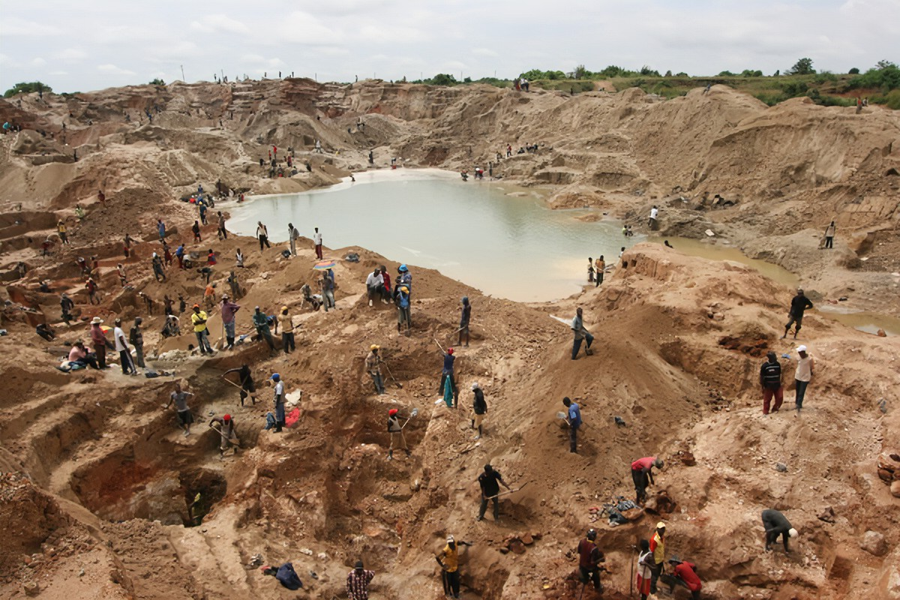
Katanga and the UMHK
The company.
Fear of Lumumba.
First mercenaries.
UN involvement.

Slide 6
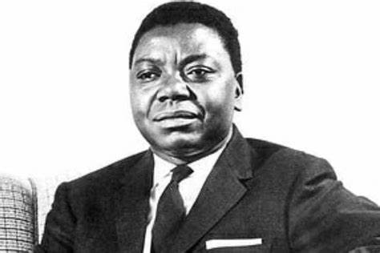
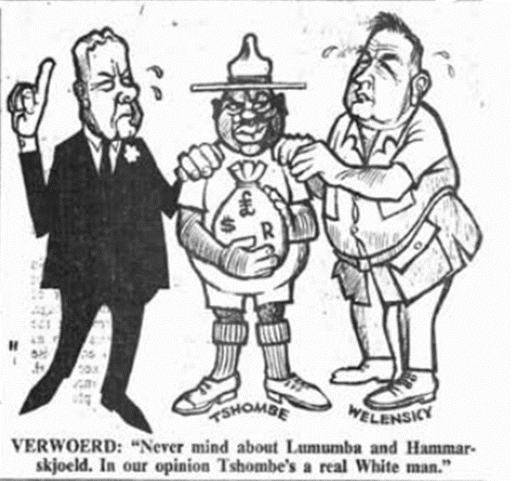
Moïse Tshombe as PM of the DRC
Exile from Katanga.
Rising tensions.
PM of the DRC.
Legacy today.
PM of South Africa (Hendrik Verwoerd) on the left and PM of Rhodesia (Roy Welensky) on the right. Both of whom were in charge of an apartheid government in Africa.

Slide 7
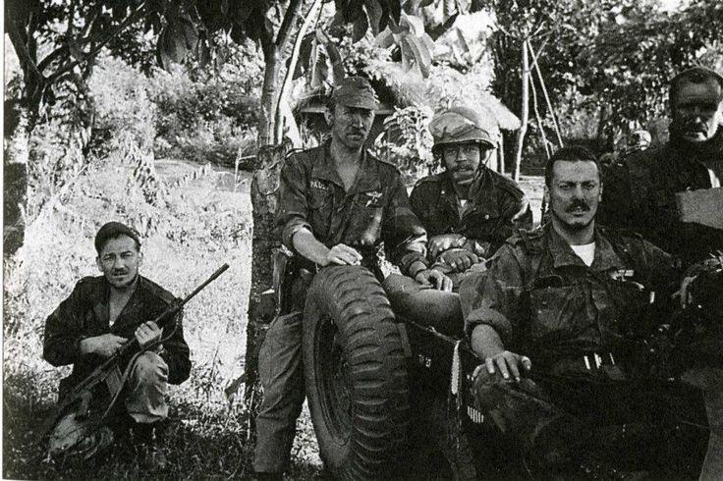
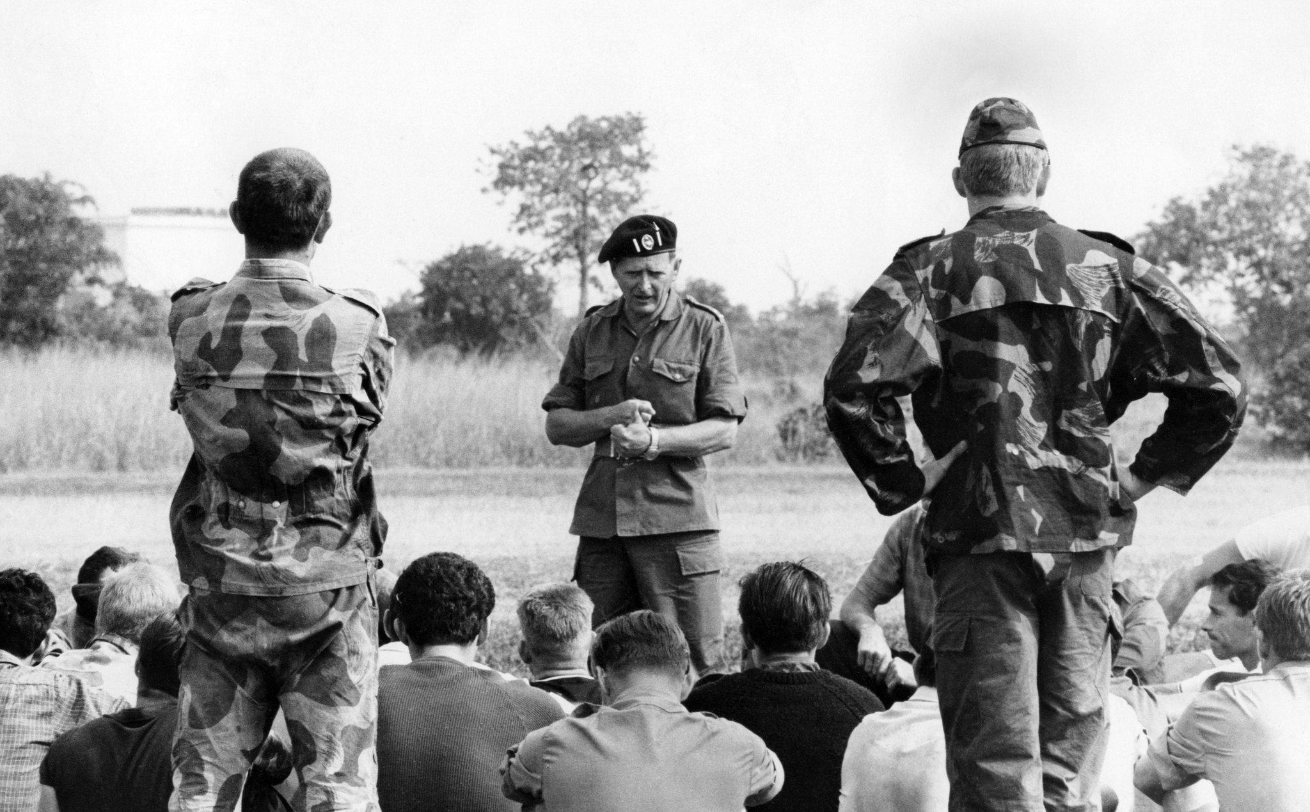
Mercenaries throughout the Crisis
Killers, thieves, and accountants.
Who worked for who?
Mutinies in Stanleyville.

Slide 8
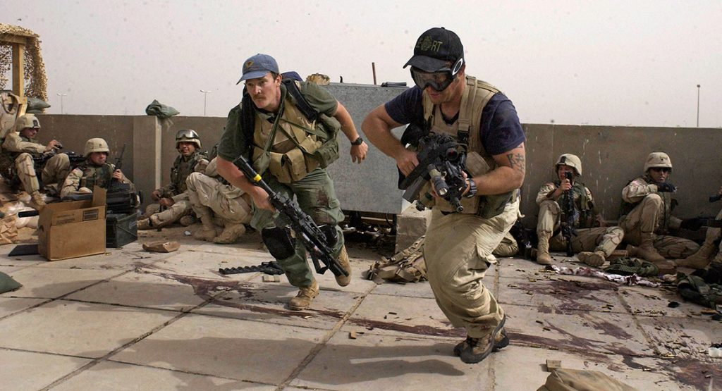
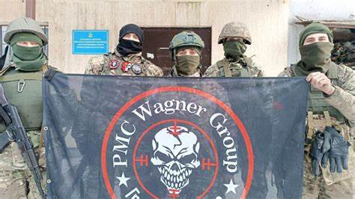
Conclusion
Mercenaries to PMCs.
Today’s clients.
Continued research?

